Slide 1
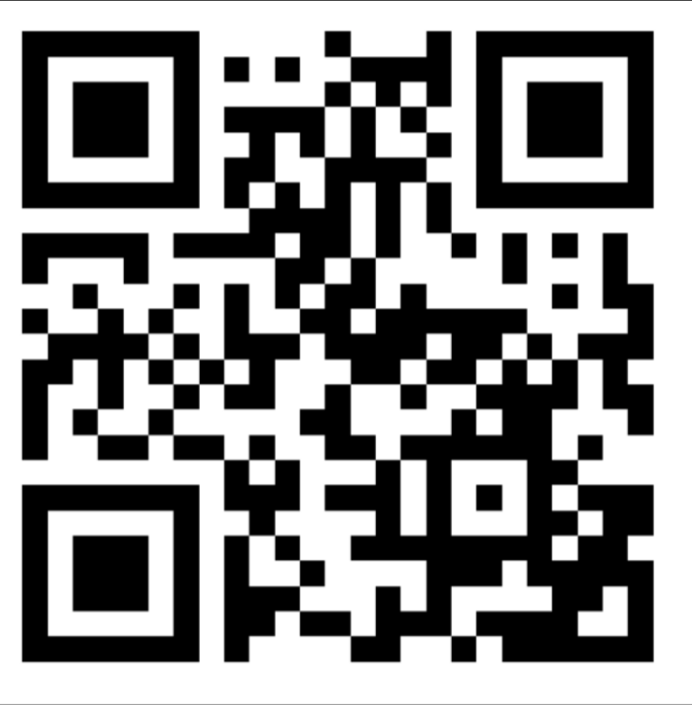
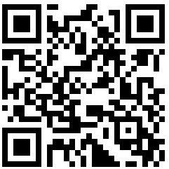
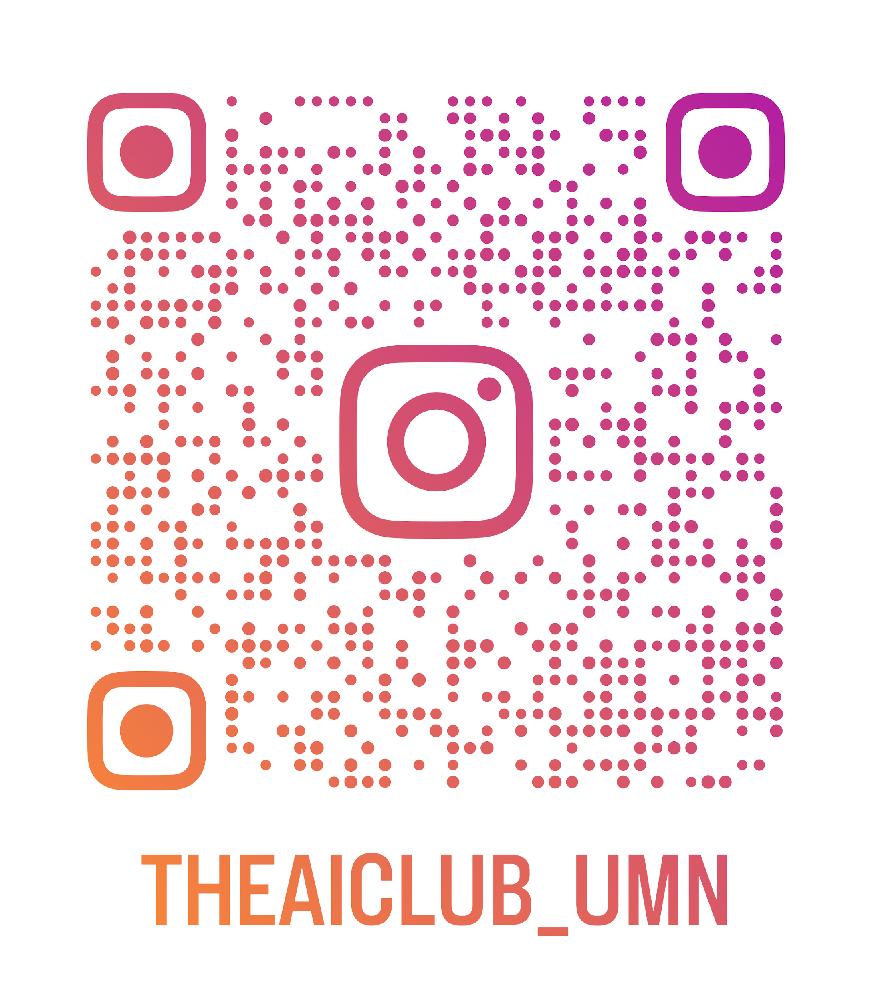
Welcome to GAI
Discord
RSVP for Workshop 1
Instagram
First Meeting

Slide 2
Club Overview/Plans for the Semester
Biweekly meetings on Tuesday, from 6:30-8pm in Lind 302
~6 meetings this semester, breakdown is:
1 introductory
2 workshops
3 project-based

Slide 3
DISCLAIMER!!
Robert is a genius, I am not, I am still in the very early stages of learning
We wanted to continue this club so that we would all have a place to continue learning more about gen ai along with others
If anyone has knowledge about gen ai and would like to try their hand at teaching/giving a talk, we are open to that and any other suggestions

Slide 4
Food and socialize

Slide 5
About Generative AI

Slide 6
What is Generative AI? How does it work?
Generative AI is a category of AI that is capable of creating new content based on input data
Trained using vast amounts of data, then it uses learned patterns from related content to generate new outputs to a prompt

Slide 7
Example Use Cases
Text Generation - create emails, workout plans, impersonate others, grammar checker, etc.
Image - Concept art, fashion design, architectural designs
Audio - personalized music, sound effects, voiceovers
Video - educational content, special effects, low-level simulations for demos
Multimodal - everything

Slide 8
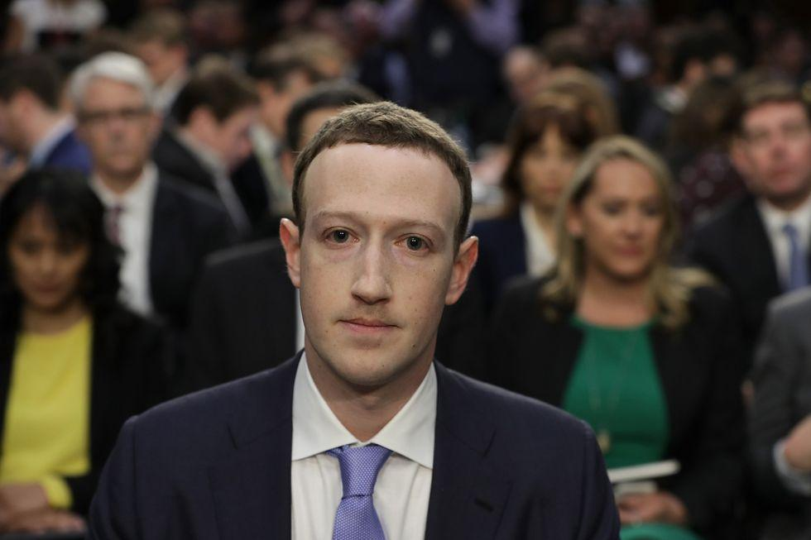
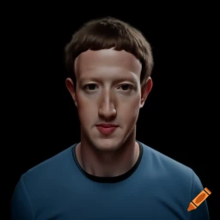
Popular Models by Use Case
Text Generation - GPT3, BERT, HuggingFace Transformers,
Image - Dall-E, Stable Diffusion, Midjourney, Imagegen
Audio - Jukebox, AudioLM, Bark
Video - Runway Gen 2, Stable Diffusion Video, Make-A-Video
Multimodal - GPT4, LLaMA 2, PaLM 2

Slide 9
Popular Libraries - Python
LangChain (at-scale apps)
OpenAI (API calls)
Groq (API calls)
Pinecone (embeddings)
LlamaIndex (RAG)
PyTorch
HuggingFace
NumPy
Keras
Tensorflow

Slide 10
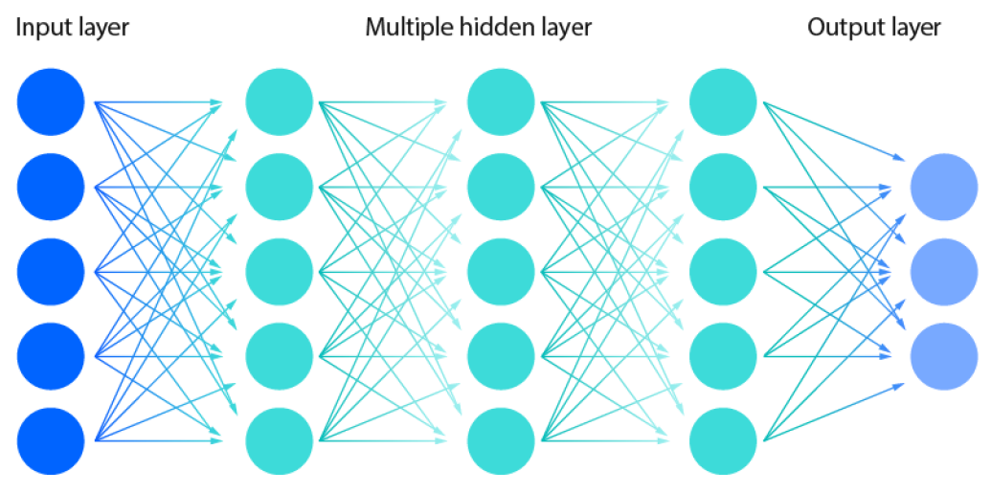
What are LLMs?
LLMs are a kind of generative ai that specialize in human language
Learns how to predict the next word in a sequence based on the massive amount of text data it is trained on
Breaks down prompt into tokens, ie “I love GAI” -> [“I”, “love”, “GAI”], then each token is given a numerical representation
Neural networks take these numerical representations and process them to predict following tokens, basically generating new text

Slide 11
Uses and Limitations
Good for text summarization, translation, and creative writing without any specific training
Can generate text that is contextually appropriate and feels natural
Problematic when they’ve learned from biased data sets and generate prejudiced outputs
Don’t actually “understand” language, just recognize patterns, so LLMs may “hallucinate” and generate convincing-sounding false information
They’re just making the most plausible connections and generating an answer

Slide 12
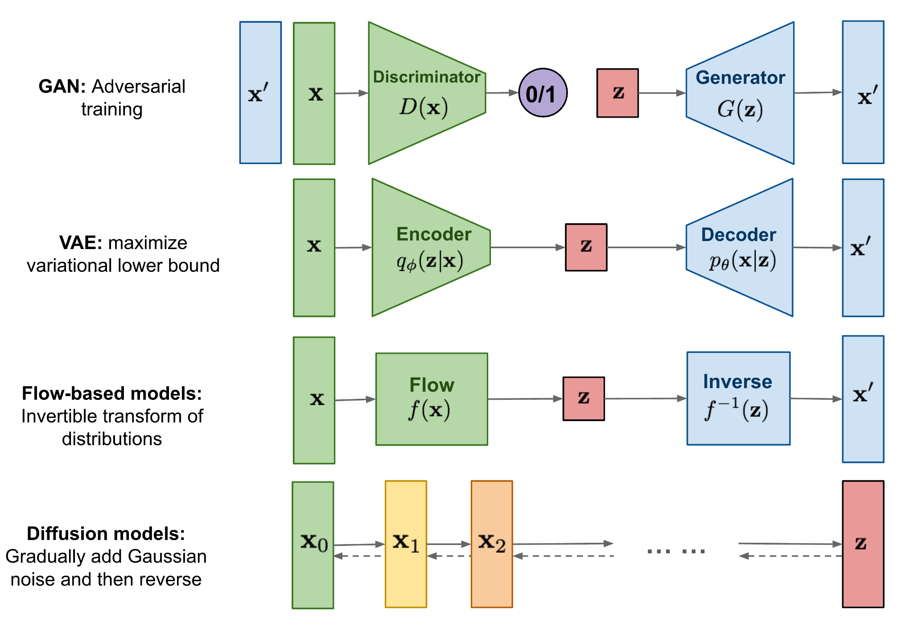
Kinds of Generative Neural Networks

Slide 13
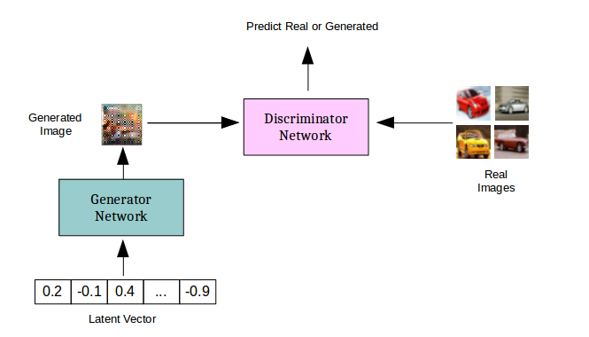
GANs (generative adversarial networks)
Train a network to come up with convincing fake data

Slide 14
Setting up our environment
Colab: https://z.umn.edu/gai-firstmeetcode

Slide 15
Creating Your OpenAI API Key
https://platform.openai.com

Slide 16
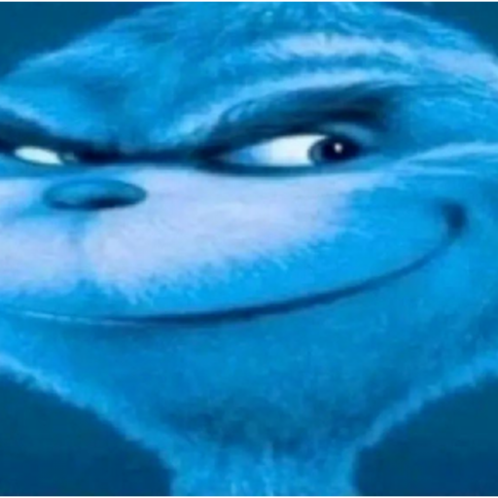
Please do not Leak
Your API Key

Slide 17
Setting up Colab Environment
Colab: https://z.umn.edu/gai-firstmeetcode

Slide 18
Prompt Engineering
Play around with the system and user content and see what kind of interesting responses you can get
Talk with those around you and share what you found

Slide 19
Recent AI News

Slide 20
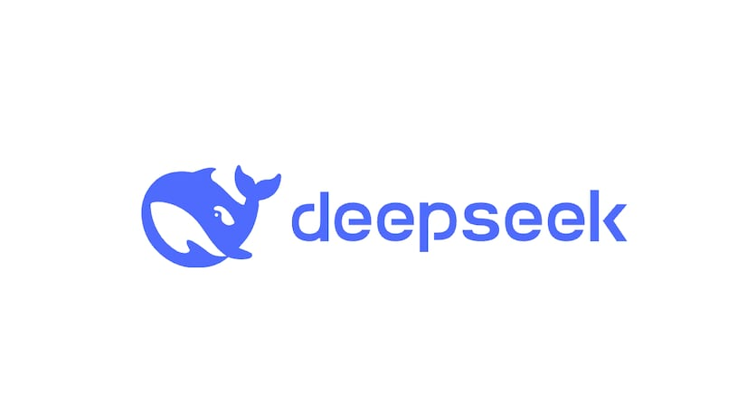
DeepSeek
DeepSeek released DeepThink-R1 on 1/20/2025
Cheaper than competitors - people not yet fully sure how
Didn’t use very expensive chips to train
NVidia Stock fell 11% yesterday following this news
If legit, API call prices are going to fall & increased widespread adoption
Expect China data stealing talk from gov

Slide 21
Other News
Great article on progress in gen ai for audio: https://www.assemblyai.com/blog/recent-developments-in-generative-ai-for-audio/
^Also explains some of how those models work

Slide 22
Kahoot

Slide 23
THANK YOU!

Slide 24
RSVP for Workshop 1
https://z.umn.edu/gai_first_workshop

